Slide 1
Acoustics and Colorimetry
Seminary 3

Slide 2
Problem 3.1 Getting acquainted with Fletcher curves
The 10 kHz sinusoidal signal of a wave generator is connected to a loudspeaker. A meter away from the loudspeaker the sound pressure level (SPL) is 10 dB. Diminishing the frequency of the generator without changing the amplitude, at 1 kHz
30 dB SPL is measured, while further decreasing the frequency to 100 Hz, the SPL will be 0 dB.
a) What is the loudness level of the 10 kHz signal in phon?
b) What is the loudness level of the 1 kHz sound in phon?
c) What is the loudness level of the 100 Hz sound in phon?
d) How you explain that the sound pressure levels are different while the output power of the generator was constant in all the above frequencies?

Slide 3
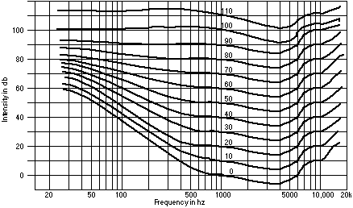
The Fletcher–Munson curves
?

Slide 4
Problem 3.2 Loudness of compound signals
In an experiment we make a sound effect with two signals, a 1 kHz one with 60 phon loudness level and a 1.1 kHz one with 66 phon.
a) Give the sound pressure of each signal in mPa!
b) What is the joint loudness level of the above sound effect?

Slide 5
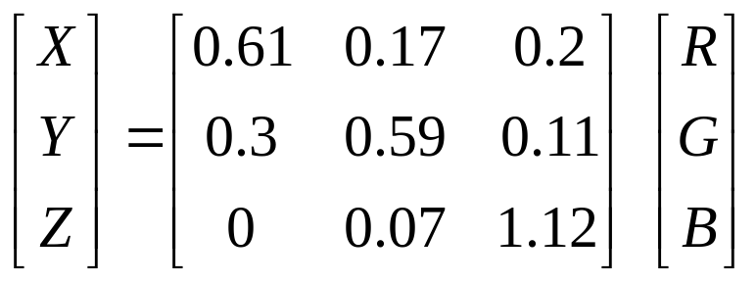
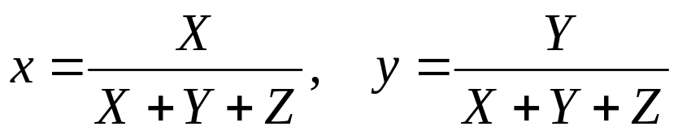
Problem 3.3 The colors of TV
Using the CIE chromaticity diagram, let us determine
the luminance,
the dominant wavelength,
the excitation purity
of the basic FCC RGB colors.
R_{FCC}: (R,G,B)=(1, 0, 0) → X=0.61, Y=0.3, Z=0 → x=0.67, y=0.33
G_{FCC}: (R,G,B)=(0, 1, 0) → X=0.17, Y=0.59, Z=0.07 → x=0.20, y=0.71
B_{FCC}: (R,G,B)=(0, 0, 1) → X=0.2, Y=0.11, Z=1.12 → x=0.14, y=0.08

Slide 6
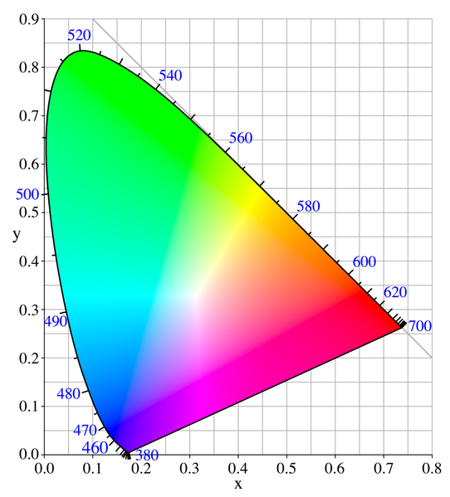
R_{FCC}: x=0.67, y=0.33
G_{FCC}: x=0.20, y=0.71
B_{FCC}: x=0.14, y=0.08
λ_{R}=610 nm
λ_{G}=536 nm
λ_{B}=470 nm
e_{p}=a/(a+b)
e_{R}=1.0, e_{G}=0.8, e_{B}=0.9
b
G_{FCC}
a
E
R_{FCC}
B_{FCC}

Slide 7
Problem 3.4
The most common analogous input of a TV set is the compo-nent video. It has three pairs of wire: one for the luminance (Y) signal, and two for the chrominance, i.e., the C_{R}=R-Y and C_{B}=B-Y signals.
a) What color we will see the bride’s white robe if we inter-change the two chrominance cables?
b) What kind of colors are insensitive for the change of chrominance signals?

Slide 8
E-white: X=Y=Z
x=0.33, y=0.33
C-white: R=G=B
x=0.309, y=0.316
G_{FCC}
C
E
R_{FCC}
B_{FCC}

Slide 9
Problem 3.5 Resolution of the human eye
It’s a well known statement that the Great Wall is the only human made object that can be seen from the Moon’s surface with naked eye. On the basis of your knowledge about the human eyesight, decide if it is true or not.
Help: The Earth–Moon average distance is 385,000 km, and the resolution of the human eye is approx. 2’.

